Slide 1


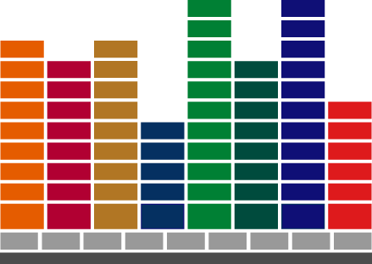

Slide 2
Agenda
Usage Of SconF
Mapping and synchronization between CTO and Workshop
Overview on SCONF workshop
Basic rule setup

Slide 3
  Sales Configurator
  generates valid product, pricing or service configurations
Proposal/quote/report/order generator
  Provides any output of detailed information of the customer’s configuration including: proposals, quotes, orders, contracts, terms, bill-of-materials

Slide 4
Sales Rules
Determines “legal” configuration for configured part during configuration entry by for instance:
  Checking validity for variable value characteristics
  Making options or option values available or unavailable
  Automatically selecting option values
Defined in Sales Configurator Workshop
Notes:
Making option values for discrete option characteristics available or unavailable based on entered option values
Automatically selecting option values by combinations of previously entered characteristic values

Slide 5




Sales rules examples
Choice Exceptions
Country
Europe
UK
North America
Power System
115 Volts
240 Volts
400 Volts
Notes:
If EUR (Europe) or UK (United Kingdom) is chosen as the country, the user can not select 115 volts.
If NA (North America) is chosen as a country, the user can not select 400 volts.

Slide 6
Sales rules examples
Set Defaults
Country
Europe
UK
North America
Power System
115 Volts
240 Volts
400 Volts
Notes:
If EUR (Europe) is chosen as the country, the user can not select 115 volts, 400 volts is set as the default, but the user can change the selection to 240 volts.
If UK (United Kingdom) is chosen as the country, the user can not select 115 volts, 240 volts is set as the default, but the user can change the selection to 400 volts.
If NA (North America) is chosen as a country, the user can not select 400 volts, the default is set to 115 volts, but the user can still select 240 volts.

Slide 7
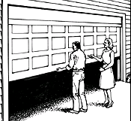

Sales rules examples
Auto Selection
Country
Europe
UK
North America
Emergency Stop
Basic
Childproof
Notes:
Emergency Stop is a non-mandatory characteristic.
If NA (North America) is chosen as the country, the Childproof Emergency Stop system must be included. The user can not choose the Basic Emergency Stop system.

Slide 8
IFS/CTO & Sales Configurator
Terms Mapping
IFS/CTO | Sales Configurator
Configuration Family | Family/Catalog
Base Part | Configurable
Characteristic | Optional
Variable Value | Characteristic
Discrete Option | Option Value

Slide 9
Groups
Connection between SCONF and Base Part setup
  Shows what is available and/or mandatory
Terminology
  Folders
    Main Item = Base Part/Inventory Part
    Options = Characteristics
  Tabs
    Available Items = Available characterstics for base part
    Belong Items = Values for characteristics
    Enable Groups = Aligning offline usage to online behaviour.
Notes:
Lack of synchronization legacy from old decision to just push data from CTO, manual maintenance was required in WS.
A version must be created from the WS to achieve full synch when base part changes have been made.
Enable Groups setting e.g. to prevent a characteristic to be entered twice is There is a maximum column that should be defaulted to 1 for discrete characteristics and # for variable.

Slide 10
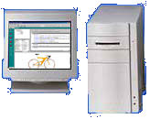
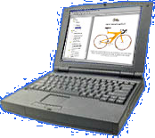



Data Flow and Components
Sales Configurator
Workshop
Sales Configurator
Customer
Profile
Catalog
Items,
Pricing
Proposals,
Orders,
AtP
Configurations
Proposals
Quotes
Business Rules
MES Documents
Back Office

Slide 11
IFS/Sales Configurator Integration
Sales Configurator integration for Configuration Family established when sales part created for configurable part
Sales Configurator Client runs in “invisible” background mode during IFS/CTO configuration entry
User updates IFS/CTO with Sales Configurator Workshop information manually by creating a “version”
Notes:
The Sales Configurator consists of two parts, The Workshop where the rules are set up and the client that executes the rules.
Sales Configurator integration for Configuration Family established (i.e. characteristics and option values become available in workshop) when sales part created for configurable part within family
Sales Configurator Professional runs in “invisible” background mode during IFS/CTO configuration entry
User updates IFS/CTO with Sales Configurator Workshop information manually by creating a “version” which updates IFS/CTO when it is invoked.

Slide 12
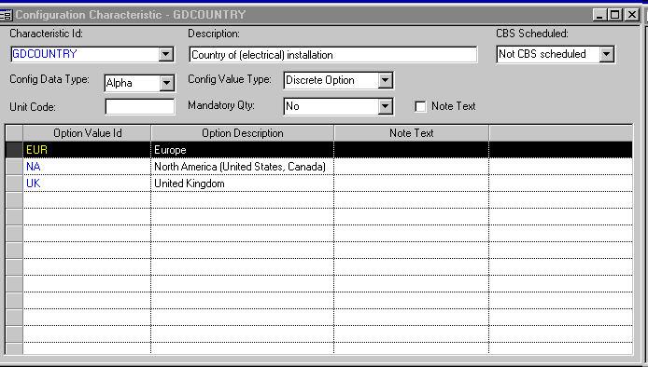

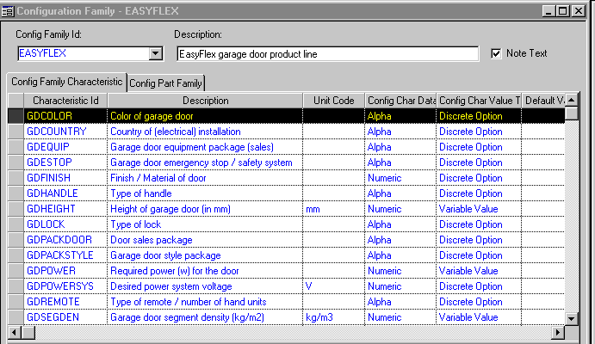
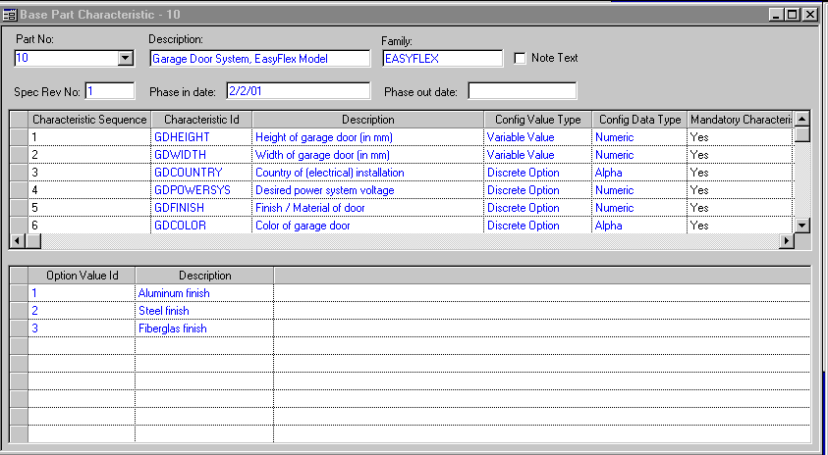
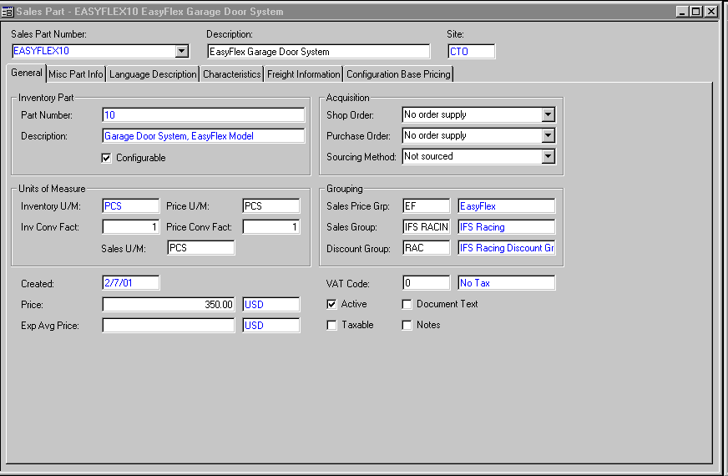

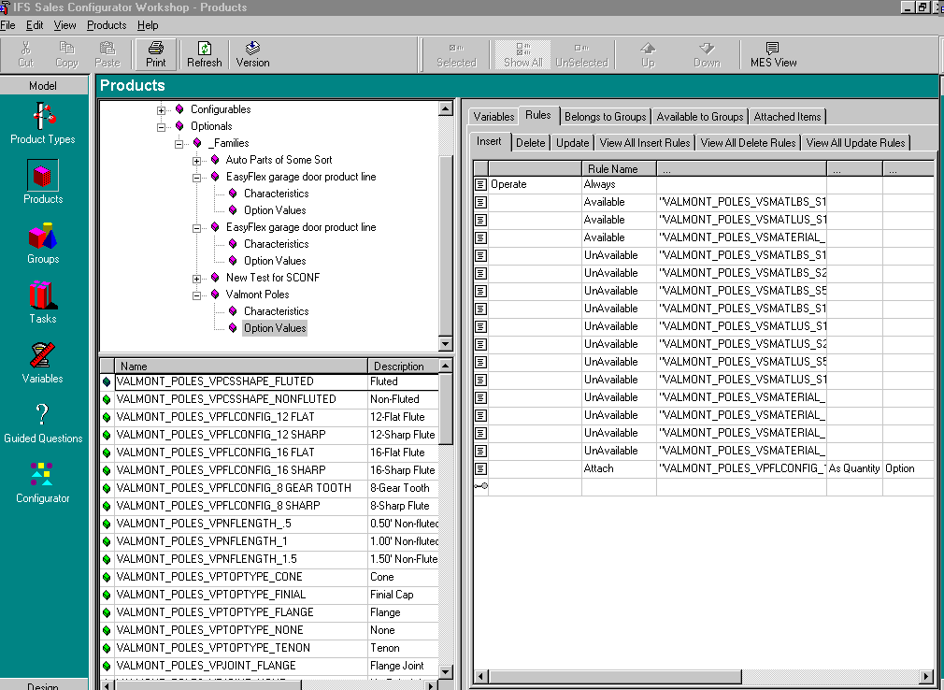
Base Set-up
Configuration Family
Base Part
Characteristics
Characteristics
Configuration Family
Base Part
Sales Part
Family
Configurable
Characteristics
Option Values

Slide 13
Adding Characteristics and/or Option Values
Add Characterics and/or Option Values
Characteristics
Add to Configuration Family
Configuration Family
Add to Base Part
Base Part

Slide 14
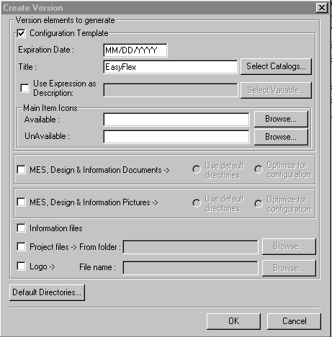
Making Rules Available for IFS
Enter/Maintain Rules
In Workshop
Create Version for Catalog
Oracle
Database
Flat File
XXXX.xtm
(not used)
Shared with
IFS Apps

Slide 15
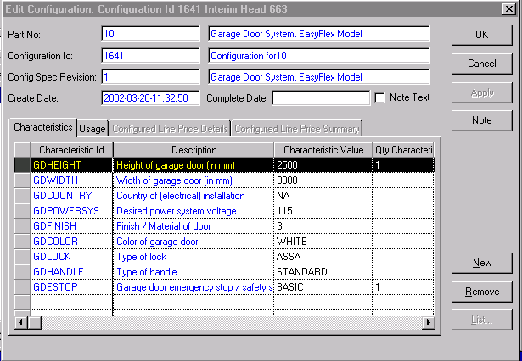
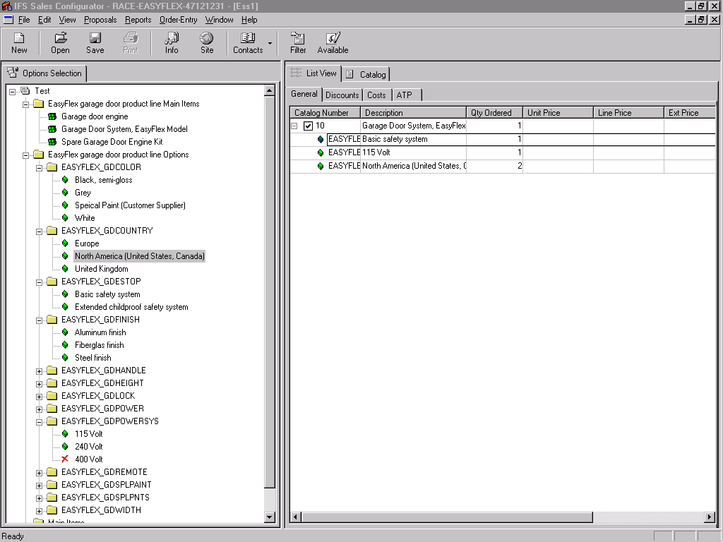
Accessing Sale Rules in IFS
Create/Edit Configuration
Sales
Rules?
Oracle
Database
Yes?
Sales Configurator
Professional
(Invisible!)
Shared with
Sales Configurator

Slide 16
Sales Configurator Workshop
Usage
  Used to create rules for IFS Sales Configurator Client
  Extends rules capabilities for IFS/CTO
  Runs as a 3rd party application with different user interface than standard IFS Windows or Web interface
  Uses IFS/CTO data as a basis for rules creation

Slide 17
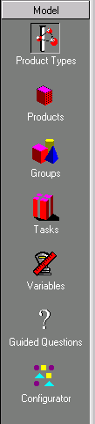
Workshop Subsystems
-
Model
Add, update and delete Product Type info (Super-Product level).
Add, update and delete Items, their Rules and Constraints.
Define Item Groups and their behavior (1st degree).
Define actions, using Rules. (i.e Functions or Procedures).
“All-in-one” frame for product level Variables divided into sub-categories.
Selection definition for the GQ Wizard
Define the visual “catalogs” for the SC user.

Slide 18
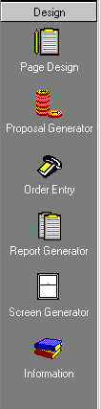
Workshop Subsystems
-
Design
Create Sections to be used in PG, OE and RG.
Create Templates for Proposals and Quotes.
Create Order Entry forms.
Create Templates for Reports.
Create Data Entry screens appearing in SC.
Create General, not item specific, information for your System.

Slide 19
Sales Configurator Workshop
Basic sales rules
  Attach
  Detach
  Unavailable
  Available
  Message
  Set

Slide 20
Basic Sales Rules
Attach
Allows the automatic selection of an option value for a discrete option characteristic or the inclusion of a non-mandatory variable value characteristic.
Used to:
  set a default for a discrete option characteristic
  select automatically included options (e.g. the “sports package” includes racing wheels and a CD player)
  make a non-mandatory discrete option characteristic available by selecting one of the options
  make a non-mandatory variable value characteristic available

Slide 21
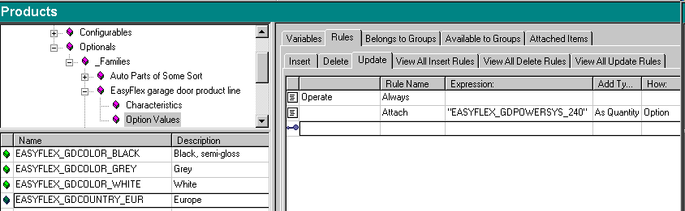
Basic Sales Rules
Attach Example
If the user chooses country Europe (GDCOUNTRY = EUR) it makes 240 the default for the garage door power supply (GDPOWERSYS = 240)
Notes:
. If the user chooses Europe (GDCOUNTRY = EUR) as the country it makes 240 the default for the garage door power supply (GDPOWERSYS = 240)

Slide 22
Basic Sales Rules
Detach
Allows removal of an option value for a discrete option or a variable value characteristic
Used to:
  remove a previously selected option value
  remove a non-mandatory variable value characteristic

Slide 23
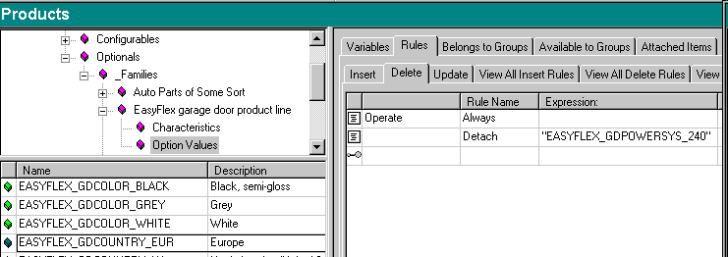
Basic Sales Rules
Detach Example
If the user chooses to change Europe as the country then 240 may be “de-selected” for the garage door power supply (GDPOWERSYS)

Slide 24
Basic Sales Rules
Unavailable
Makes an option value for a discrete value characteristic unavailable (or invisible) for selection
Used to:
  make an option values unavailable for discrete option characteristics
  to insure “legal” selection of option values when used with “available”

Slide 25
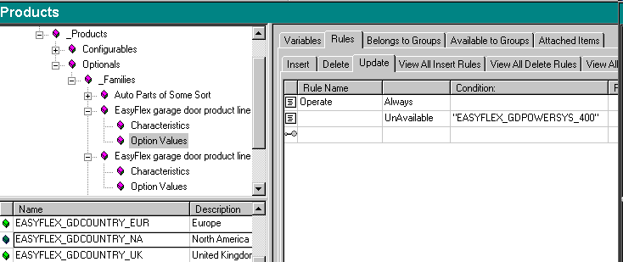
Basic Sales Rules
Unavailable Example
When selecting North America for country (GDCOUNTRY = NA), 400 is not allowed as a selection for garage door power supply (GDPOWERSYS can not = 400)

Slide 26
Basic Sales Rules
Available
Makes an option value available (or visible) for selection
Used to:
  make an options value available for discrete option characteristics
  to insure “legal” selection of option values when used with unavailable

Slide 27
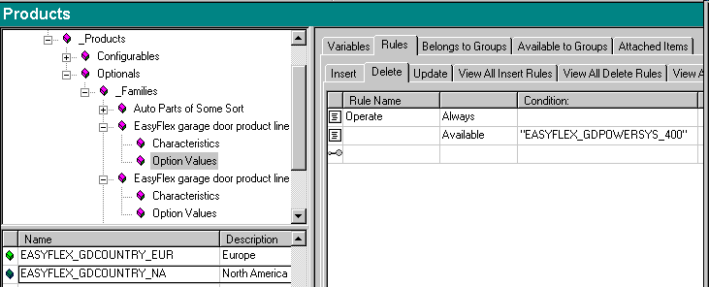
Basic Sales Rules
Available Example
When the user is changing the selection for country (GDCOUNTRY no longer = NA) from North America, 400 is now allowed as a selection for garage door power supply (GDPOWERSYS can = 400)
Notes:
When making an option value available, the option value must be have been set-up in IFS/CTO for the characteristic for the base part.

Slide 28
Basic Sales Rules
Message
Sends a message to the dialog box
Used to:
  Check validity of entry for variable value characteristics
  User information

Slide 29
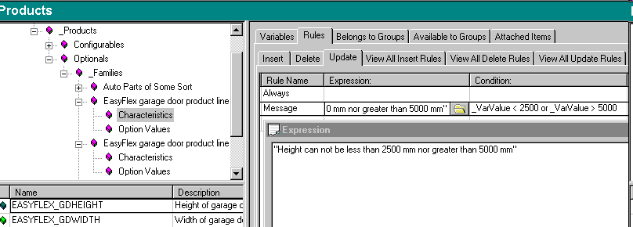
Basic Sales Rules
Message Example
The garage door height (GDHEIGHT) can not be less than 2500 mm nor more than 5000 mm

Slide 30
Basic Sales Rules
Set
Sets value for characteristic
Used to:
  Set a value for a variable value characteristic.
  (Note: Required when attaching a variable value characteristic to make it available for IFS/CTO)

Slide 31
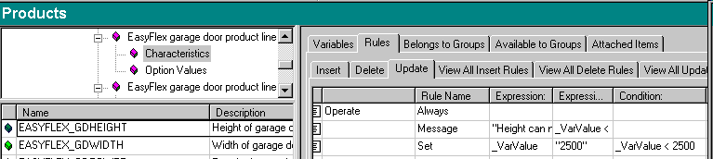
Basic Sales Rules
Set Example
When entered value for the garage door height (GDHEIGHT) is below the minimum (2500), the value is set to the minimum.

Slide 32
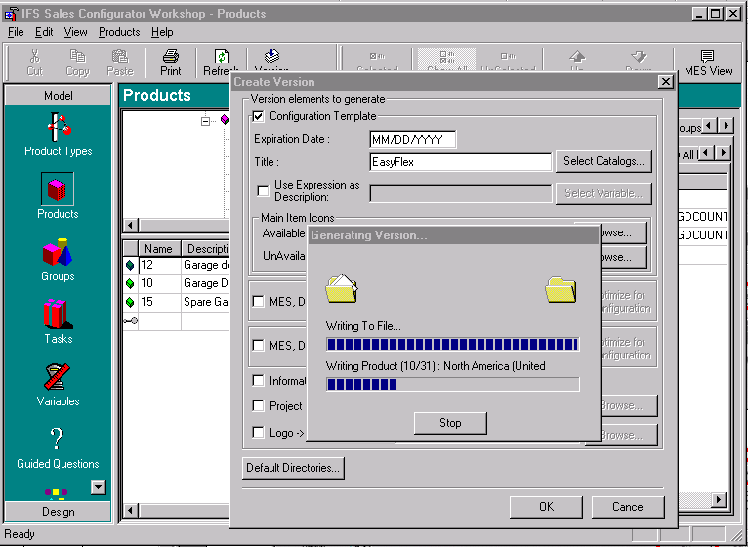
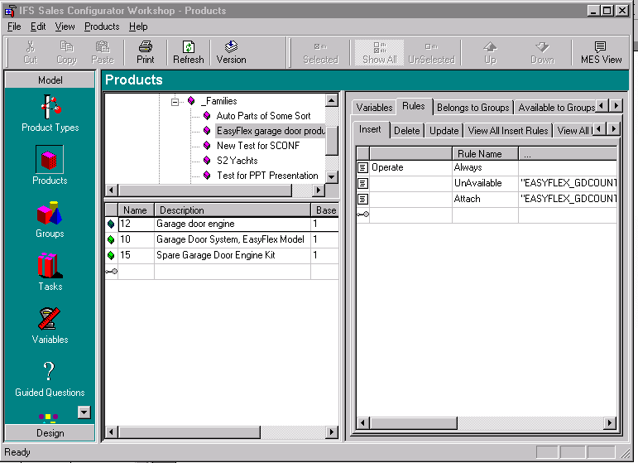
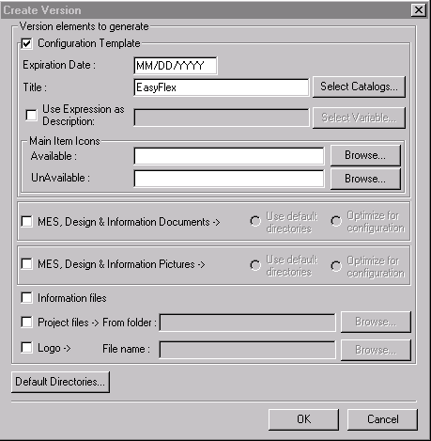
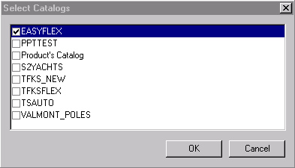
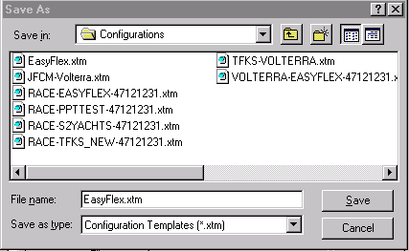
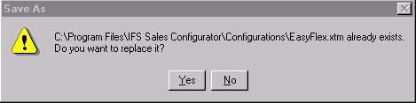
CTO Configuration Rules
Building Versions
Doesn’t Matter!

Slide 33
SCONF homepage info
Sconf homepage
  Troubleshooting
  Training documents
  Release material
  User guides

Slide 34
IFS – THE GLOBAL ENTERPRISE APPLICATIONS COMPANY

